Slide 1
Overview Of Wood Pellet Delivery Case
April 13, 2022

Slide 2
Supply Chain Map
Source
i
(8)
Storage Buffer i
(8)
Storage depot j
(14)
Demand region k
(14)
SW
SW
HW
HW
Transhipments between storage depots are allowed
Model does not include last-mile delivery from region to customer
All decisions for period t can be fully executed within the period
No activity takes more than one period

Slide 3
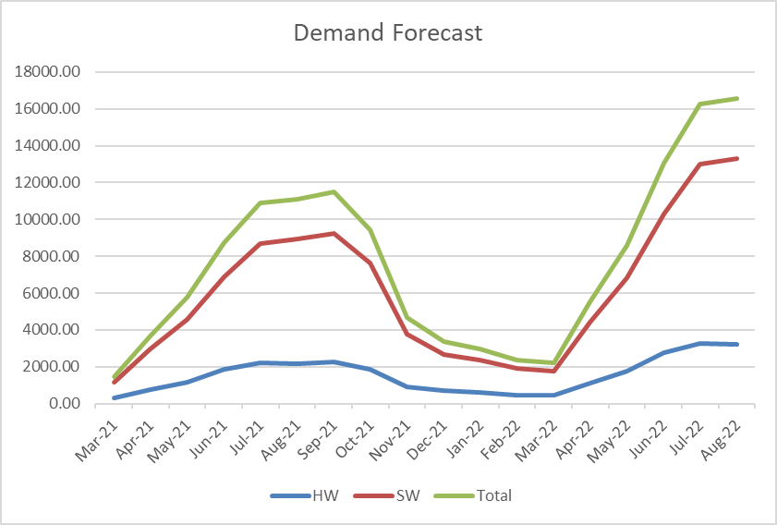
Monthly Demand Is Nonstationary
Notes:
Units are tons

Slide 4
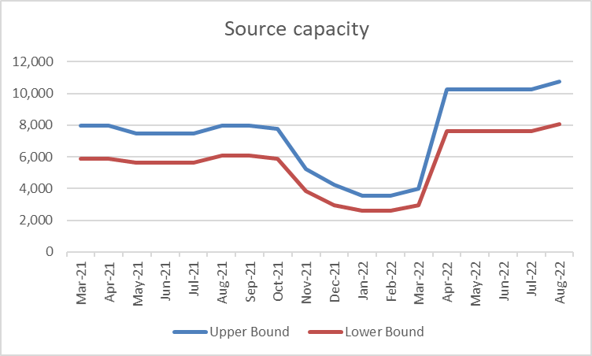
Source Capacity Is Nonstationary With Bounds

Slide 5
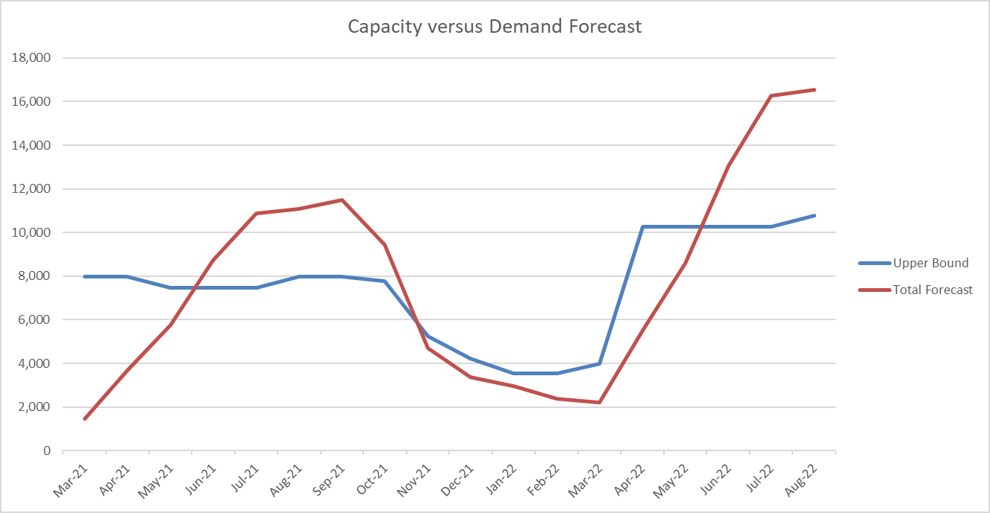
Demand And Supply Are Not Balanced

Slide 6
WPD’s Aggregate Planning Model: In Words
Optimize profit by maximizing revenue at minimum cost
Determine
  Which demands to satisfy
  How much to buy, from whom and when
  Where to store inventory
  How to distribute
Take into account constraints on
  Min-max agreements with each source
  Storage capacities
Implement decisions for first time period(s) and then re-plan
There are many ways to formulate this aggregate production planning problem. What follows is just one such formulation.

Slide 7

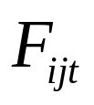
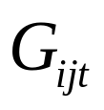
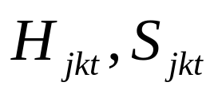
Decision variables
Flow from each source i to its buffer in each time period t
Flow from each source i to each storage depot j in each time period t
Flow from each source buffer i to each storage depot j in each time period t
Flow from each storage depot j to each demand region k in each time t period for each type of wood pellet H,S
  When j=k this is a last-mile delivery
  When j<>k, this is a transhipment from one depot to another, plus the last mile deliver (all in period t)

Slide 8
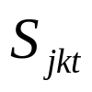
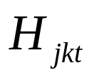
Supply Chain Map, With Math Programming Details
Source
i
(8)
Storage Buffer i
(8)
Storage depot j
(14)
Demand region k
(14)
SW
SW
HW
HW

Slide 9
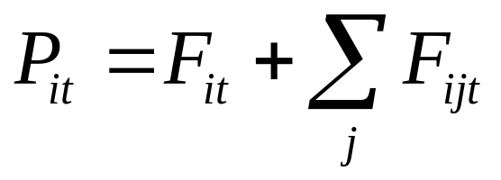
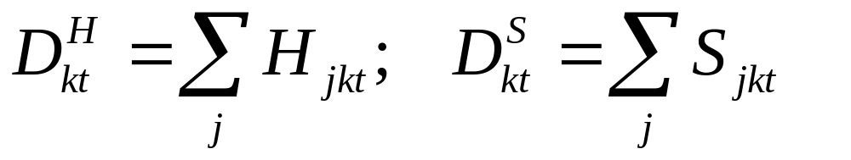
Procurement And Fulfillment Are Intermediate Variables
Procurement quantity from each source i in each time period t
Amount demand fulfilled in each demand region k in each time period t

Slide 10

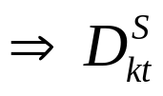
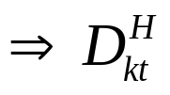
Supply Chain Map, With Math Programming Details
Source
i
(8)
Storage Buffer i
(8)
Storage depot j
(14)
Demand region k
(14)
SW
SW
HW
HW

Slide 11
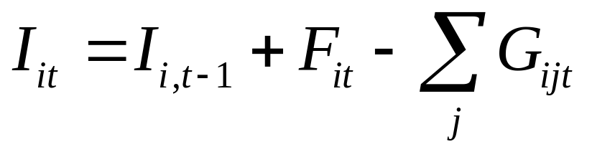
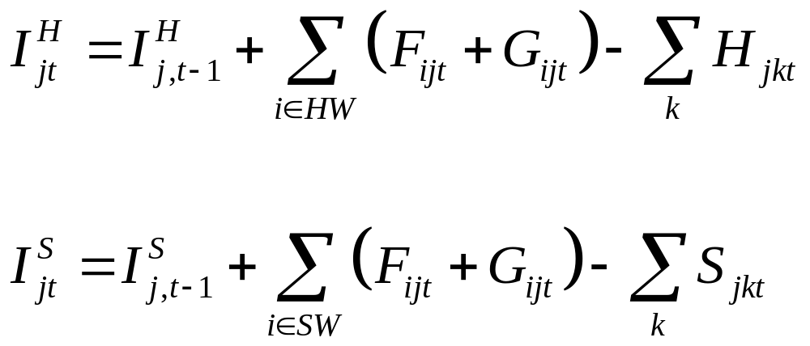
Inventory On Hand Is An Intermediate Variable
Inventory at each source buffer i in each time period t
Inventory at each storage depot j in each time period t for each type of wood pellet H,S

Slide 12

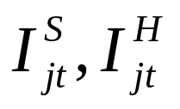
Supply Chain Map, With Math Programming Details
Source
i
(8)
Storage Buffer
i
(8)
Storage depot j
(14)
Demand region k
(14)
SW
SW
HW
HW

Slide 13

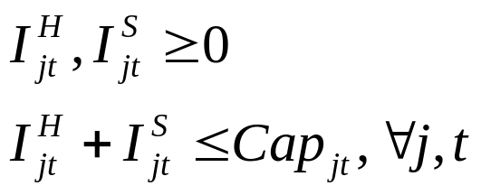
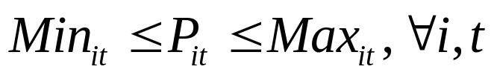
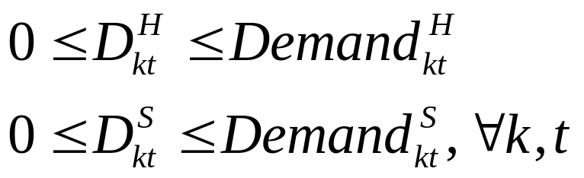
Constraints
Buffer inventory:
Storage depot inventory:
Procurement quantity:
Demand fulfilled:

Slide 14
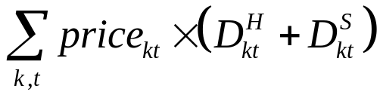
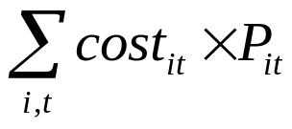
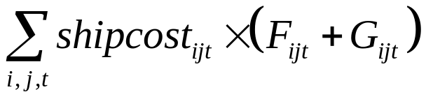
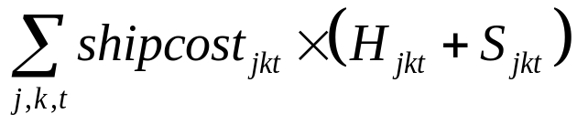
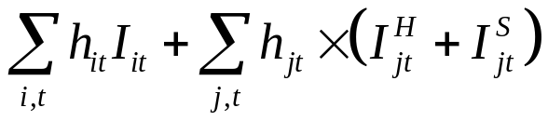
Objective Function Maximized Profit (Rev - Cost)
Revenue
Procurement cost
Transportation costs
Transship costs
Storage costs
Ignores last-mile costs of depot to customer

Slide 15
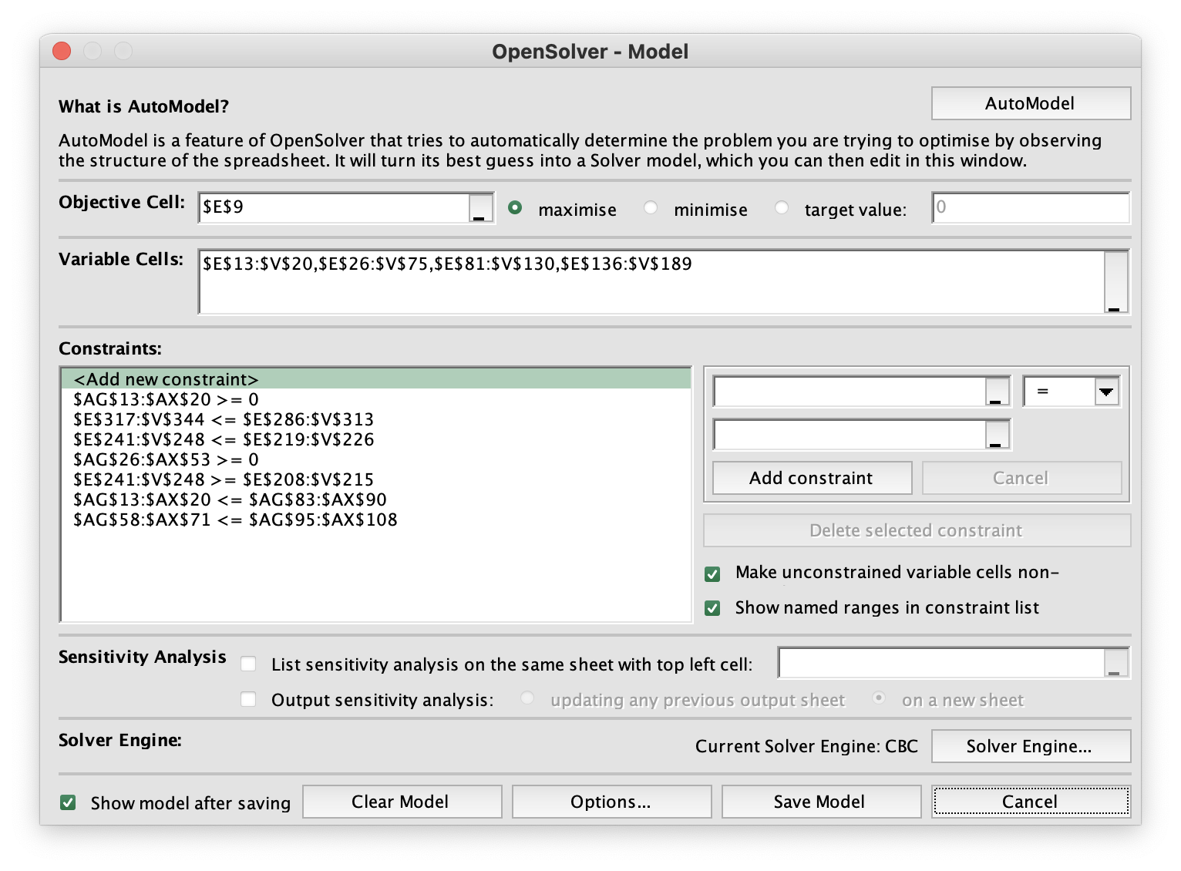
OpenSolver Formulation
Maximize revenue minus procurement
cost, transportation cost, tranship cost,
and storage costs
Flow from source to storage buffer
Flow from source to storage depot
Flow from storage buffer to depot
Flow from storage depot to region
Inventory at storage buffer can not
go negative
Fulfilled demand can not exceed
region’s demand forecast
Procurement volumes at source can
not exceed upper bound on source
availability
Inventory at storage depot can not
go negative
Procurement volumes at source
must exceed lower bound on
source availability
Inventory at storage buffer can not
exceed available capacity
Combined inventory at storage
depot can not exceed available
capacity

Slide 16
Problem Formulation
We are trying to balance “real” with “realistic” with “doable”
  2,916 decision variables
  OpenSolver solves in less than a minute
Spreadsheet contains optimal solution
You are can rerun and experiment, but not expected to do so
Hand in one slide with your best insight to share with Wood Pellet Delivery
In Friday’s recitation, I will review the spreadsheet formulation more carefully
  Resulting video will likely prove to be a good cure for insomnia

